Slide 1

UE18CS390A – Capstone Project Phase – 1
Project Progress Review #3
Project Title : PerfectCrop - The right crop for your soil.
Project ID : PW22RBA01
Project Guide : Prof. Raghu B A Rao
Project Team : PES1201800051 Srish Srinivasan
PES1201800089 Akash Kumar Rao
PES1201800102 Vishruth P Reddy
PES1201800291 Ishan Agarwal

Slide 2
Abstract
Our project comes under the domain of Precision Agriculture. It helps farmers make informed decisions with regards to the kind of crop they must invest in to get good returns. The aim of this project is to build a predictive model to recommend the most suitable crop to grow based on the various parameters that influence the fertility of the soil.

Slide 3
Scope
This project enables the farmers to grow the most suitable crop by factoring in various soil characteristics like N (Nitrogen), P (Phosphorus), K (Potassium) contents, pH and atmospheric conditions like temperature, humidity and rainfall. This results in greater yield of crop and therefore, stabilizing their financial status. In this project, the focus is on analyzing the existing data and employing suitable models in order to give the best recommendations possible to the farmers.
Among the two data sources we have, one of them is only limited to 22 crops but covers the entire country. The other source is area specific, that is, it has the soil details of Karnataka which has all the nutrient values in soil.

Slide 4
Suggestions from Review - 2
Our guide, Prof. Raghu B A Rao, asked us to look for better sources of data and gave some suggestions such as ISRO and GKVK.
We got in touch with Dr.K Ganesha Raj, the General Manager of RRSC South, ISRO seeking for useful data related to our project. They assigned Dr.Ramasubramoniam, Soil and Agri Scientist to guide us through our project. The scientist will be providing us with area specific soil and crop data gathered by ISRO over the past years to carry out our project.

Slide 5
Design Approach
The design approach we have planned on using is as follows:
Choose a specific geographic location like a district or state, for eg: Karnataka.
Gather past data for the chosen area.
Allow the users to enter real-time data into the application.
The application will predict and display a list of crops along with their yield percentage which will be ranked in hierarchy.
In the backend, the machine learning models such as SVM, Decision Trees, ANN etc will process the data provided and will predict the range of crops.

Slide 6
Design Approach
The reason for choosing a smaller area is that, in precision farming, we can get better yield if we focus on a smaller area. Taking a larger area and generalizing the obtained results may give inaccurate predictions and can lead to wrong suggestions.
Although we have data for the entire country, this can lead to wrong suggestions due to a large amount of missing and inaccurate values.
The benefits of following this approach is that farmers or horticulturists have to only input the soil and atmospheric data in the application as they get the values from their local bodies. Instead of making decisions based on intuition, this is a more promising and scientific approach for better yield.

Slide 7
Design Constraints, Assumptions & Dependencies
Our current model factors in all the soil and atmospheric details of the entire country and predicts the output of the crop. After going through literature surveys related to our line of work, we have found out that focusing on a smaller area of interest leads to more accurate results.
Since the values are to be manually entered by the users, they must make sure that they enter it correctly or else the model will lead to wrong predictions and will result in low produce.
Another assumption is that N, P, K and other soil nutrients values are available for the smooth working of the model.

Slide 8
Design Constraints, Assumptions & Dependencies
Other necessary dependencies are:
Good quality network connection to use the web application
Good quality network connection to install the mobile application
After the installation is complete, network connection is not required to make use of the application.
A minimum of 4 GB of RAM is a must for the smooth functioning of the application.
The mobile must have Android as its operating system.

Slide 9
Proposed Methodology / Approach
We are following the waterfall model approach as:
Requirements are fixed and will in all probability remain the same
No ambiguity in the requirements
The technology to be used is well understood
It is a short project with a duration of 6 months
Notes:
If any need arises in the future to add an additional component to the current project, then we will be switching to an incremental approach and in turn will be following the waterfall model for each of these increments.

Slide 10
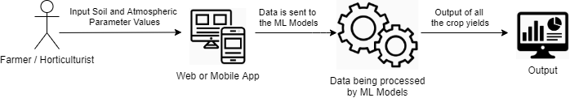
Architecture
Notes:
.

Slide 11
Architecture
The following user groups can make use of our application:
Farmers and Horticulturists.
Surveyors and Government officials
Researchers.
Notes:
Farmers and horticulturists can use this application to maximise their profits and land use which will eventually lead to betterment of the nation’s Agriculture Industry’s growth.
Surveyors and Government officials who want these predictions about crops for extensive areas at once. These predictions can also be used to generate revenue estimates and design budgets accordingly.
and lastly the Researchers who need data for future projects.

Slide 12
Architecture
The application components of our project are:
Web application
Mobile application
The data components of our project are:
Soil profile table by Karnataka government
User input
Notes:
Web, Mobile application
Data
For training our models, the Karnataka government has made the soil profile table public which contains all the details of soils for every district.
We also utilise the information provided by the user about the test soil via the Web application.

Slide 13
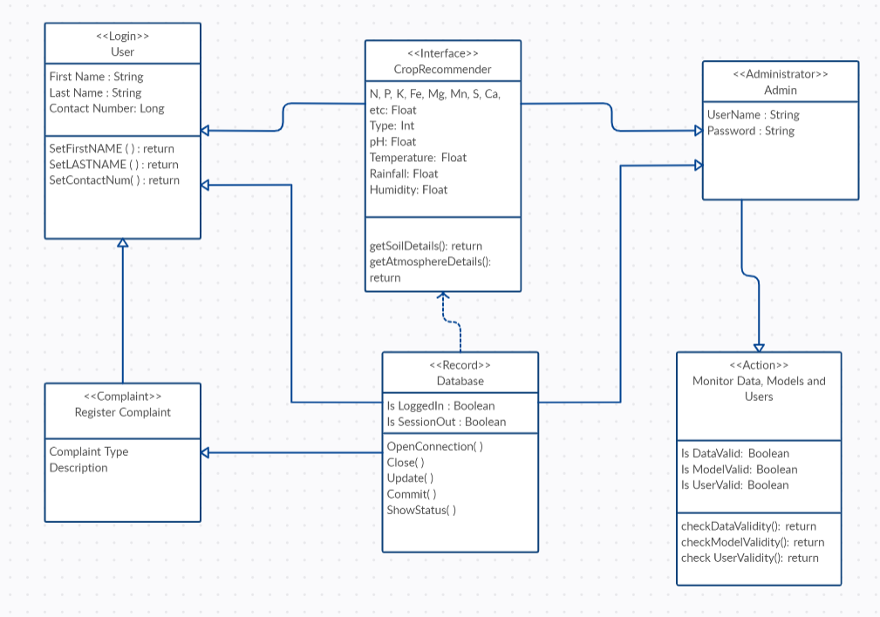
Design Description: Master class diagram

Slide 14
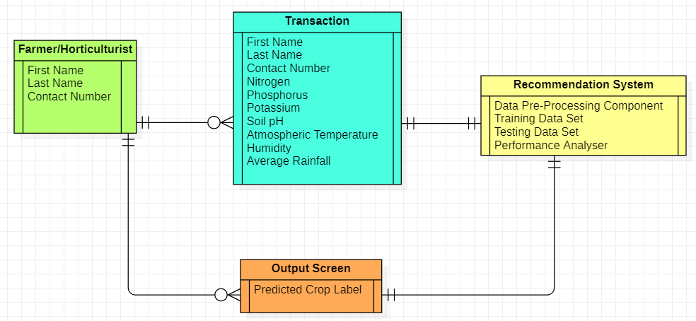
Design Description: ER Diagram

Slide 15
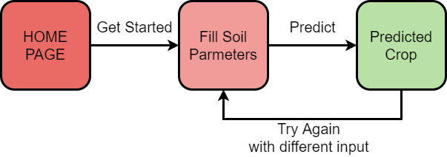
Design Description: User Interface Diagram

Slide 16
Data obtained from:
data.gov.in
ISRO
Kaggle
Design Description: External Interfaces

Slide 17
Technologies Used
Currently, we have implemented 4 machine learning algorithms namely Decision Trees, K-Nearest Neighbors, Naïve Bayes Classifier and Random Forest Classifier. Among these models, the Naïve Bayes Classifier gave the maximum accuracy of 99.47%.
We will make an attempt to implement some of the ensemble machine learning algorithms such as AdaBoost and XGBoost and also an Artificial Neural Networks model in order to achieve the recommendation of crops with a good accuracy score.

Slide 18
Project Demo
We have implemented 4 machine learning models. They are
Decision Tree
K-Nearest Neighbours
Naive Bayes
Random Forest

Slide 19
Project Progress
Through the literature survey that we conducted, we learnt about the various machine learning algorithms that have been employed to recommend the most suited crop given the required soil and atmospheric properties of a specific location.
We have also implemented 4 machine learning algorithms namely Decision Trees, K-Nearest Neighbors, Naïve Bayes Classifier and Random Forest Classifier. Among these models, the Naïve Bayes Classifier gave the maximum accuracy of 99.47 %.

Slide 20
Project Progress
We have completed about 25% of the project.
In phase-2 of this project, we will make an attempt to implement the ensemble machine learning algorithms such as AdaBoost and XGBoost and also an Artificial Neural Networks model in order to achieve the recommendation of crops with a good accuracy score.
On completing the implementation of these models, we will be building a website and an associated mobile application in order to enable access to this crop recommendation system with user friendly and elegant graphical user interface.

Slide 21
References
[1] Keerthan Kumar, T.G., Shubha, C. and Sushma, S.A., Random Forest Algorithm for Soil Fertility Prediction and Grading Using Machine Learning. International Journal of Innovative Technology and Exploring Engineering (IJITEE), 2019.
[2] Kumar, R., Singh, M.P., Kumar, P. and Singh, J.P., 2015, May. Crop Selection Method to maximize crop yield rate using machine learning technique. In 2015 international conference on smart technologies and management for computing, communication, controls, energy and materials (ICSTM) (pp. 138-145). IEEE.

Slide 22
References
[3] Palanivel, K. and Surianarayanan, C., 2019. An approach for prediction of crop yield using machine learning and big data techniques. International Journal of Computer Engineering and Technology, 10(3), pp.110-118.
[4] Patil, A., Kokate, S., Patil, P., Panpatil, V. and Sapkal, R., 2020. Crop Prediction using Machine Learning Algorithms. International Journal of Advancements in Engineering & Technology, 1(1), pp.1-8.

Slide 23
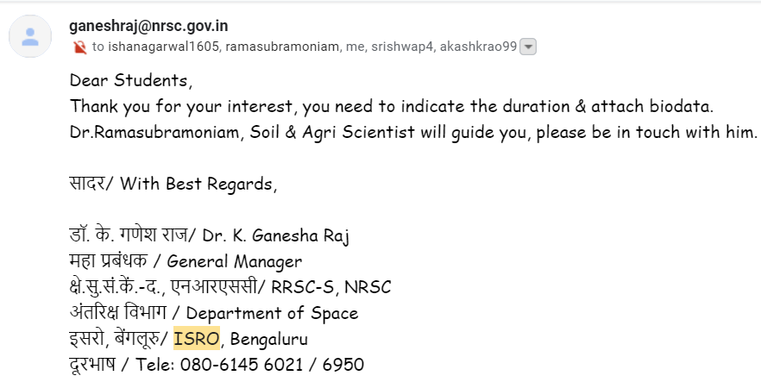
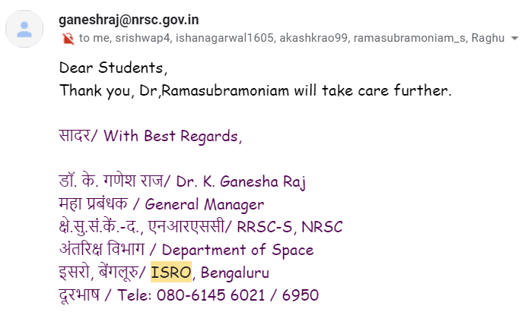
Any other information

Slide 24
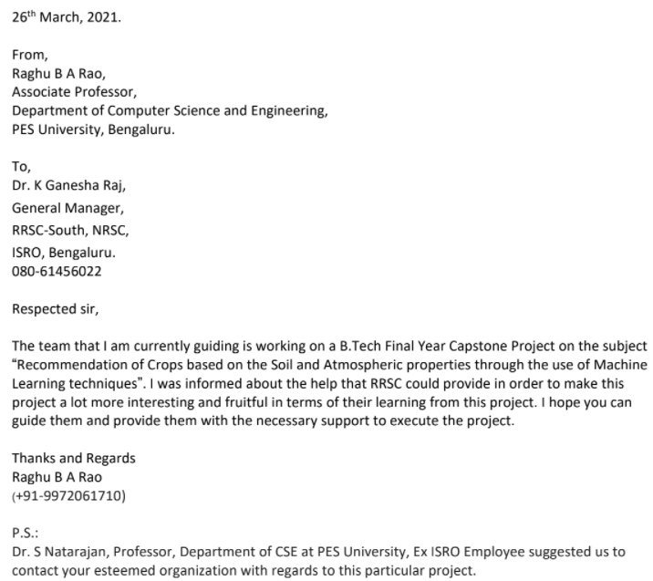
Any other information

Slide 25
Thank You

